Slide 1
Welcome to Year 2 Elm Class

Slide 2
Elm Class Staff
Class teachers- Ms. McLaughlin & Mrs Smith Support staff – Ms. Paul & Mrs Hindle & Mrs Moloney

Slide 3
School Mission Statement
Growing in knowledge and in the love of Jesus.
This underpins all that we do at St. Martin of Porres Catholic Primary School.
With our school Mission Statement we are all one family. We show this with our school uniform which we hope the children wear with pride.

Slide 4
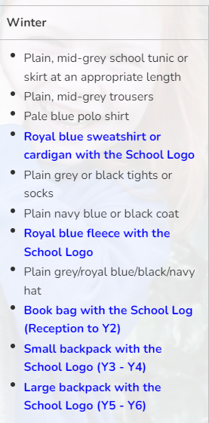
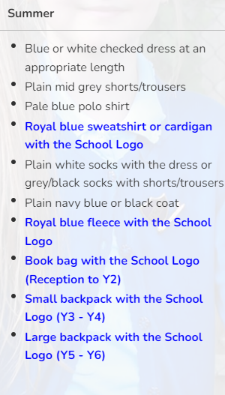
All items highlighted in blue below must be purchased from our school supplier. All other items can be bought elsewhere. The school have regular second hand uniform sales. Please check on the Friends of St Martin website pages at - http://www.stmartinofporres.co.uk/Parents/Friends-of-St-Martin-s/
https://www.stmartinofporres.co.uk/School-Uniform/

Slide 5
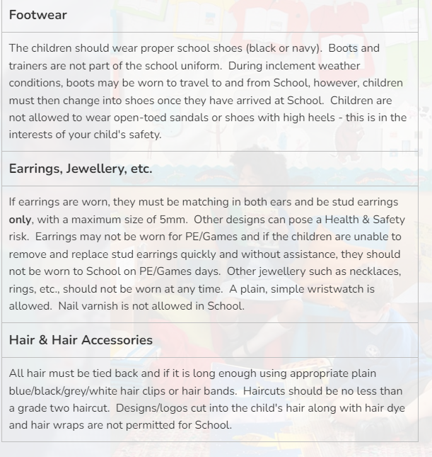
https://www.stmartinofporres.co.uk/School-Uniform/

Slide 6
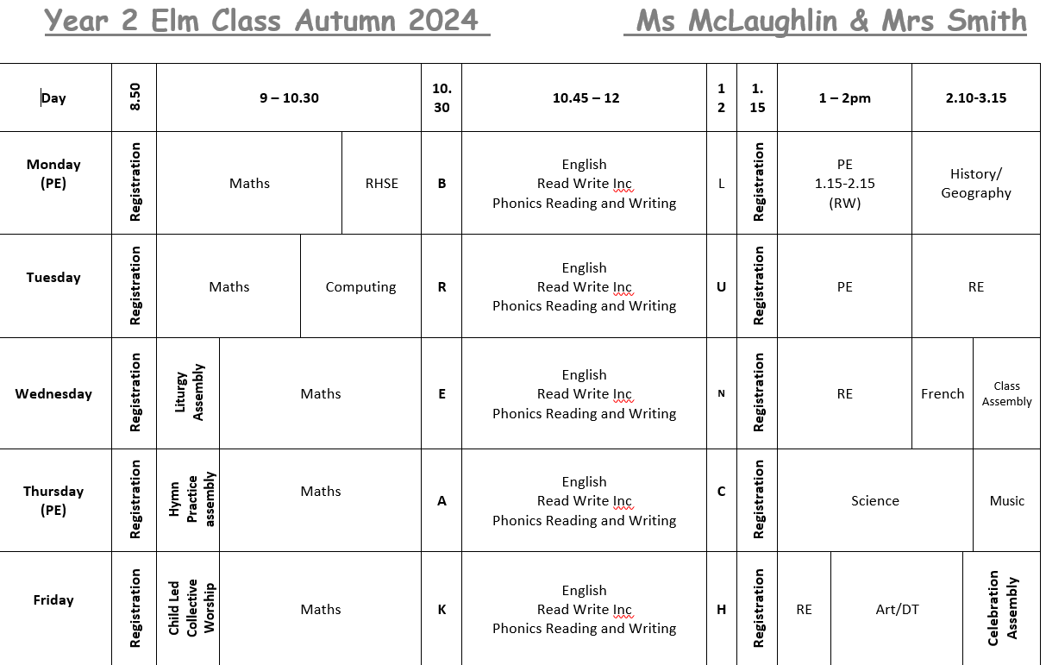
Class Timetable

Slide 7
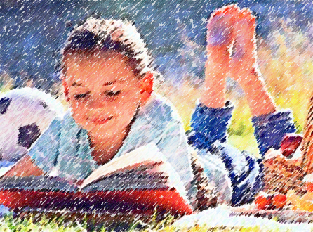
Reading in Year 2
Read in school everyday as part of their phonics session with an adult. Depending on their phonics group, children will bring home a new book every 3 or 5 days. This book is one that they will have been reading in their phonics lesson and the children should be super confident reading this to you. They will also take home a ‘Book Bag Book’ that has the same phoneme from their phonics lesson that week. A third book is one that your child will have chosen from the class library and is a book to be enjoyed with you.
Support your child by reading for 10-15 mins every night and please record your reading at home by signing the reading
journal every time you read.

Slide 8
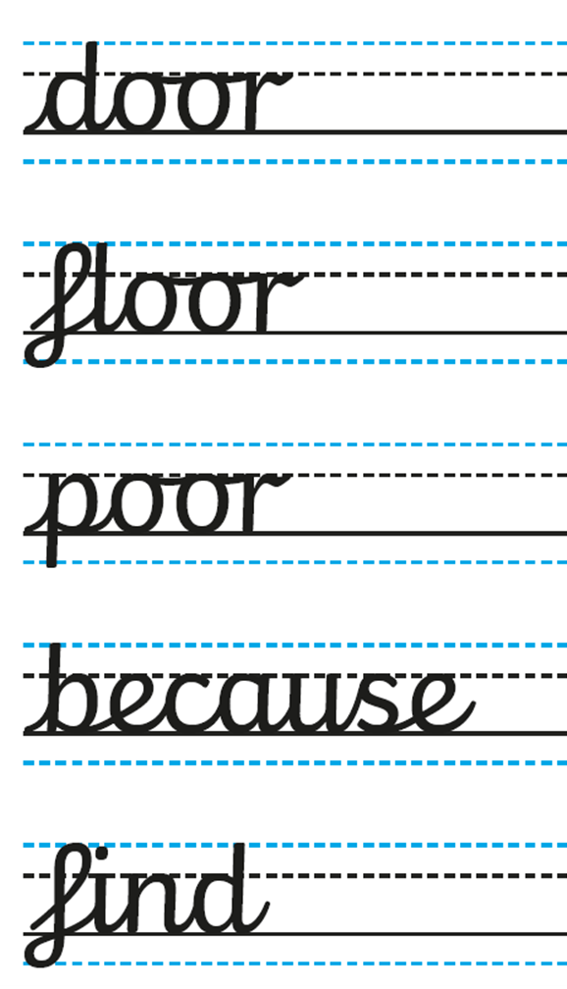
Writing in Year 2
Talk for writing - if practising at home it’s important for the child to say the sentence aloud before writing it.
An important skill the children need to develop is editing their work.
Handwriting - children should be using cursive handwriting by the end of Year 2. We will be practising this every morning.
Common Exception words - school will provide a copy. Children need to learn these by heart and use them in their writing.

Slide 9
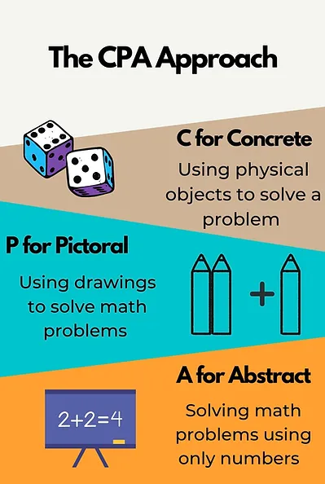
Maths in Year 2
Children will be developing their reasoning and problem solving skills. Using mathematical vocabulary and full sentences is critical in developing this skill.
Concrete, pictorial, abstract
approach (CPA) – you can use this
at home too

Slide 10
Supporting your child at home in Year 2
Displaying key words at home.
Developing independence - children to complete homework independently if possible.
Discuss with the teacher any problems regarding homework.

Slide 11
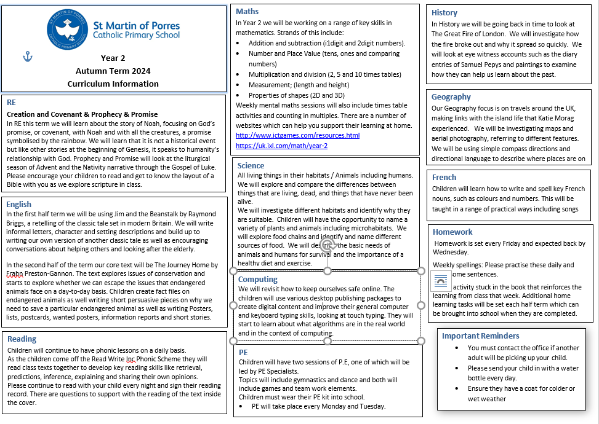

Slide 12
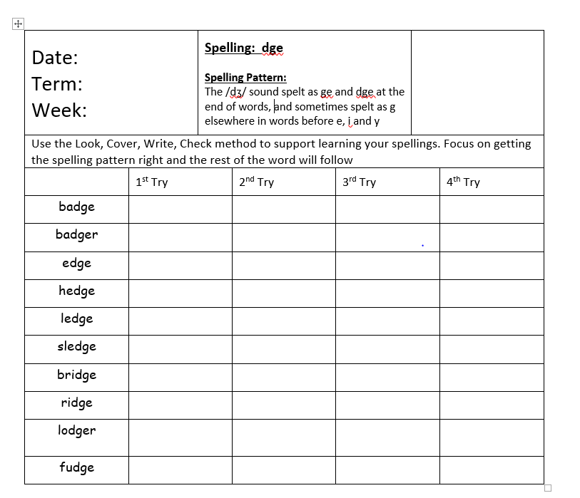
Spelling Homework

Slide 13
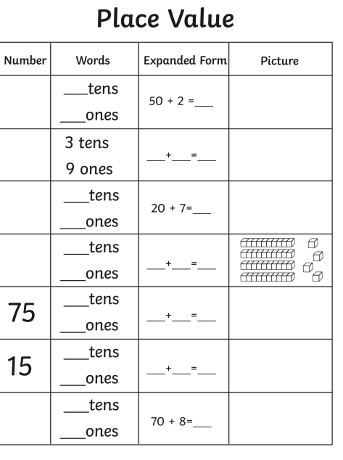
Maths Homework

Slide 14
Routines in Key Stage 1
Soft start - children will come into the class from 8:45 to 8.55 and will make a start on their mental maths starter. Please ensure they are in so they have time to settle before the lessons start at 9am.
Break is from 10.30-10.45am and the children receive fruit to eat if they would like.
Behaviour – School wide policy using the behaviour rocket.

Slide 15
Thank you for your time. Any questions?

