Slide 1


Welcome to

Slide 2
School Mission Statement
Growing in knowledge and in the love of Jesus.
This underpins all that we do at St. Martin of Porres Catholic Primary School.

Slide 3
Class teacher - Miss Dozie
Support staff – Mrs Paul, Mrs Hindle and Miss Victoria (1:1)
Phonics teachers vary depending on your child’s phonics group
Staff working with your children

Slide 4
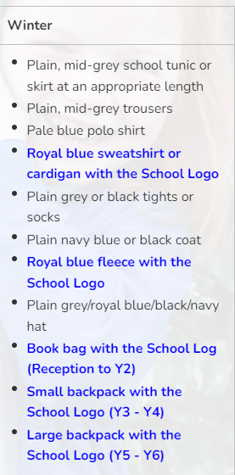
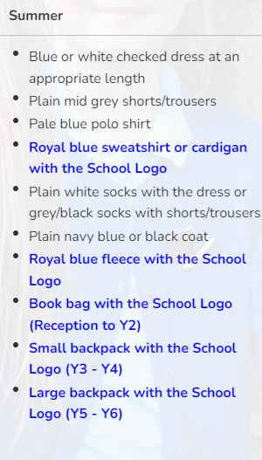
School Uniform
All items highlighted in blue below must be purchased from our school supplier. All other items can be bought elsewhere.
The school have regular second hand uniform sales. Please check on the Friends of St Martin website pages at - http://www.stmartinofporres.co.uk/Parents/Friends-of-St-Martin-s/

Slide 5
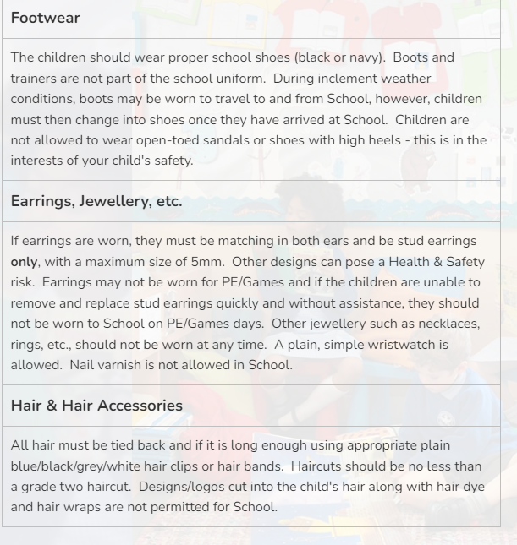
School Uniform
All items highlighted in blue below must be purchased from our school supplier. All other items can be bought elsewhere.
The school have regular second hand uniform sales. Please check on the Friends of St Martin website pages at - http://www.stmartinofporres.co.uk/Parents/Friends-of-St-Martin-s/

Slide 6
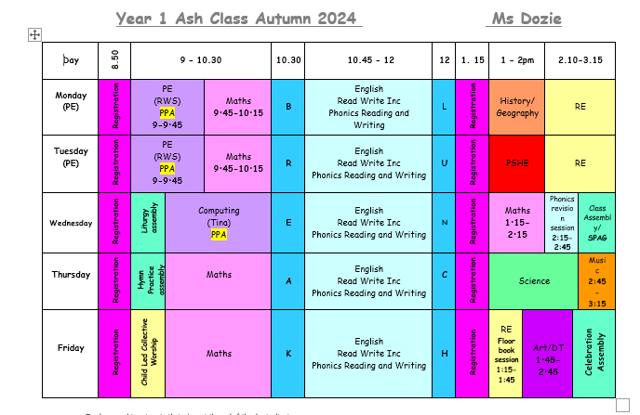
Class Timetable

Slide 7
What we are doing in Class 1
We will be focusing on transitioning the children from a play based curriculum (EYFS) to the National Curriculum through continuous provision. For the first half term (September to October) we will have many play based opportunities to learn both indoor and outdoor, then starting after half term we will be focusing on following our weekly timetable. This supports the children through their transition from EYFS. The focus will be on their:
Reading
Writing
Maths
Phonics
Religious Education

Slide 8

Religious Education in Year 1
In RE we will be following a curriculum called RED ( Religious Education Directory)
Branch one: Creation and Covenant
We will be using and referring to biblical passages, analysing the
preaching and learning how we should follow in Jesus’ footsteps as Catholics.

Slide 9


English Year 1
Non-fiction
Recount – personal experience
Chronological report
Instructions
Poetry
Rhyming couplets
Acrostic
Fiction
Realistic
Fantasy
English will be focused on a different book every three weeks. These books will help the children to discuss:
Characters and Settings
Fiction/non-fiction
Narrative
Difference and similarities
Personal preference

Slide 10
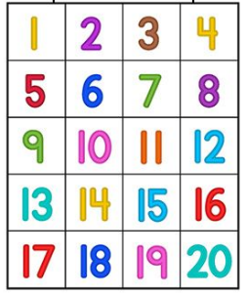
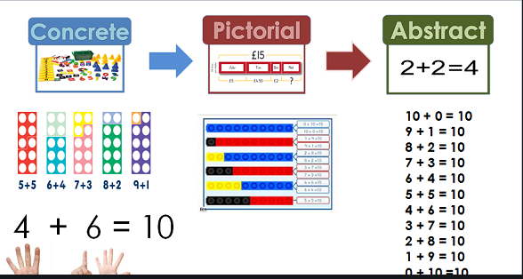
Maths in Year 1
In maths we will be focusing on using concrete, pictorial and abstract resources to promote a deep understanding of different mathematic concepts.
The focus will be on:
Place value
Addition and subtraction
Multiplication and division
Geometry: shapes, position, direction
Measurement: length, height, weight, volume, money, time
Fractions

Slide 11
Phonics in Year 1
In phonics we will be focusing on developing the children’s fluency in their sounds using the RWI. We will be developing on:
Single phonemes
Digraphs – th, sh, ch
Trigraphs – igh, air, ear
Blending – s-l-igh-t = slight – writing
Segmenting – slight = s-l-igh-t – reading
The phonics screening test consist of 40 words, 20 real words and 20 pseudo (nonsense) words. This is to focus on how the children use their phonics to sound and blend words.

Slide 12

End of Year 1 Expectations

Slide 13
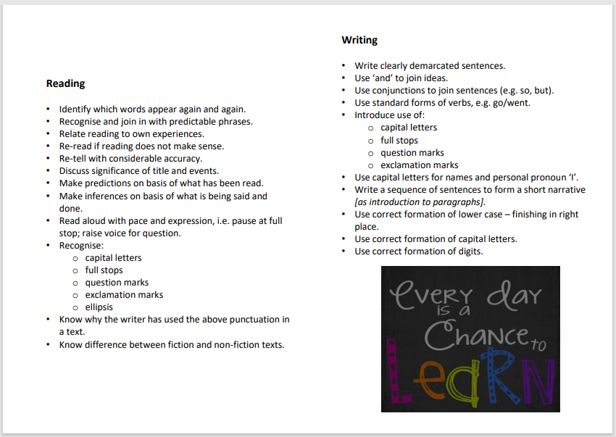
End of Year 1 Expectations

Slide 14
PE in Year 1
PE will take place on a Monday and Tuesday. Both PE lessons will be taken by Coach Louis and will be indoor and outdoor depending on the weather.
Please can your children come to school in their PE kits and wear Velcro shoes of possible.

Slide 15
Behaviour in Year 1
Positive praise is always practised in St Martin of Porres.
In every classroom there is a rocket that the children go up if their behaviour has been an example to the rest of the class. If they move to the top of the rocket then they get rewarded with a sticker.
In Ash Class I promote and encourage your children to respect all adults and children within the school on a daily basis as well as always showing good manners.
If children are consistently not following instructions they will be seated on the thinking chair to reflect on their behaviour.

Slide 16

Home Learning in Year 1
Daily reading:
To read each day for at least 10 minutes
Phonics or Maths:
Children will be given phonics or maths homework once a week on Monday to deepen their understanding of the sounds in phonics and to use their knowledge to complete independent work in maths. The home work is due back on Friday.
Some homework will be set on Numbots:
Please spend time with your child to help them understand the task, whilst encouraging independence login details will be given today.

Slide 17
Supporting your child at home in Year 1
When your child is set a reading task please support them with sounding out the letters phonetically ( videos of how to do this are on YouTube), as this is the way we are teaching your child to read in school.
If you need any support with this please speak to Miss Dozie and we can work together.
When they are given a homework task please help them to complete the task, if your child can not complete the homework task please let me know.

Slide 18
Thank you for your time
I look forward to working with your children this academic year !
Any questions?

