Slide 1

Welcome to Reception
Oak Class

Slide 2

Class teacher – Miss McEneaney
Support staff – Mrs Hindle
Staff working with your children

Slide 3
School Mission Statement
Growing in knowledge and in the love of Jesus.
This underpins all that we do at St. Martin of Porres Catholic Primary School.

Slide 4
School Mission
With our school Mission Statement we are all one family. We show this with our school uniform which we hope the children wear with pride.
https://www.stmartinofporres.co.uk/School-Uniform/

Slide 5
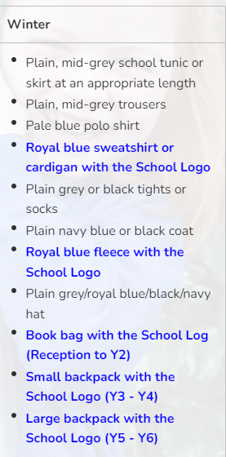
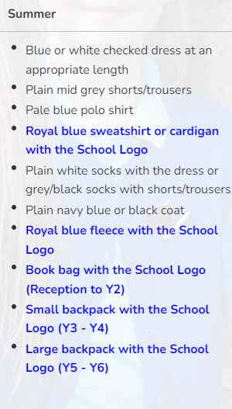
All items highlighted in blue below must be purchased from our school supplier. All other items can be bought elsewhere.
The school have regular second hand uniform sales. Please check on the Friends of St Martin website pages at - http://www.stmartinofporres.co.uk/Parents/Friends-of-St-Martin-s/
https://www.stmartinofporres.co.uk/School-Uniform/

Slide 6
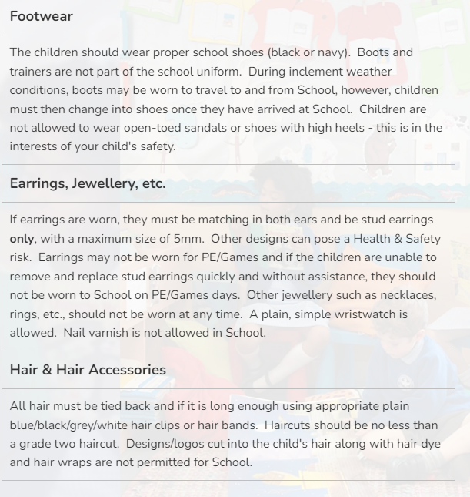
https://www.stmartinofporres.co.uk/School-Uniform/

Slide 7
Class Timetable

Slide 8
What we are doing in Reception Class
Across the EYFS Unit there will be many activities that link to the seven areas of learning:
Personal, social and emotional development
Physical development
Communication and language development
Literacy development
Mathematics
Understanding the world
Expressive arts and design

Slide 9


Literacy in Reception Class
A reading and vocabulary list has been emailed to you with authors and key words we will be learning from throughout this year.
In Reception, the children will be focusing on the author Michael Rosen in the Autumn term.
There will be communication and language activities guiding the children to discuss what the stories are about, starting to summarise different books and beginning to identify key words.

Slide 10
Literacy in Reception Class
At St Martin of Porres Primary School, we use the Read Write Inc. (RWI) programme to get children off to a flying start with their literacy. Read Write Inc. Phonics is a method of teaching reading and writing, which is centred around learning the sounds of the letters (phonics) and then blending them together to read words. The children also learn to break down words into individual sounds in order to write them. We start teaching this scheme when children arrive into the Reception Class. Each day the children will learn a new single sound, then this progresses to 2-letter sounds and vowel sounds. You can see the order of the sounds at the bottom of this information leaflet.

Slide 11
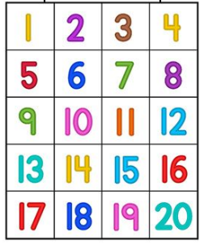
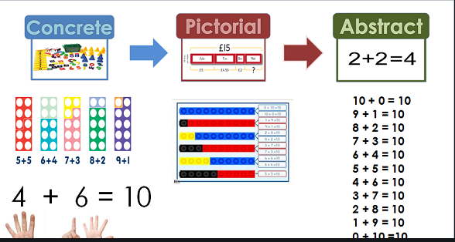
Maths in Reception Class
In Reception, we will be covering:
Numbers up to 20 using poems, rhymes and songs to help the children have an interest in numbers
We will be exploring numbers in our own environment and how maths links to our everyday life
Recognising and naming 2D shapes
Sequencing times and events
Ordering items by weight and capacity
Using positional language such as; behind,
in front, next to

Slide 12

Religious Educaiton in Reception Class
In the Autumn term, we will be covering:
Creation and covenant
The children will focus on how our world was created, how God loves us all, word and actions to the sign of the cross and how to look after the world around us.
Prophecy and promise
Focusing on the Christmas story, crating advent wreaths and understanding the meaning around them, the tradition of the crib and to retell the story of Jesus.

Slide 13
Expressive Arts and Design in Reception Class
In Reception, the children will be focusing on naming different coloured paints, pattern making, den and mask making, mark making and explaining the meanings behind their pieces of art.
Understanding the World in Reception Class
In Reception, the children will be learning about body parts and senses, different seasons, family, people who help us in the community, animals, their habitats and how to look after them. Finally, exploring animals from around the world and how they are similar and different to animals the children know.

Slide 14
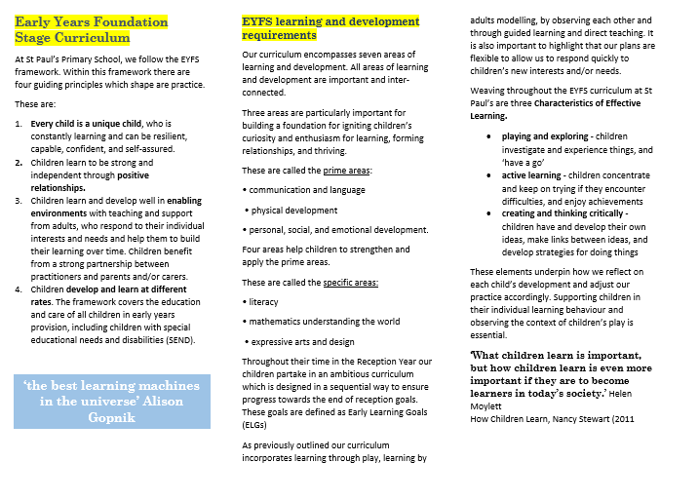
End of Reception Class Expectations

Slide 15
PE in Reception Class
Mondays and Tuesdays.
On these days please can your child come into school in their PE uniform, black trainers and hair tied back for safety reasons.

Slide 16
Enrichment Opportunities in Reception Class
We will be hoping to go on some trips after the Christmas break, according to the topics that the children will be focusing on.
When the trips are being organised, any volunteers to accompany the class would be greatly appreciated.

Slide 17

Home Learning in Reception Class
Reception Homework:
Children are expected to read at home with their parents or carers. Please write the date, title of the book, page numbers read and any comments you wish to write in the reading journal.
In the Autumn term the children will not have formal written homework however they may be set creative or physical tasks to carry out over the weekend. Any pictures of your child completing the tasks set would be appreciated. These can be uploaded onto Tapestry.
After Christmas:
Each week we will alternate with an English and maths activity.
A Phonics/English or maths activity will be set on a Friday and due in on Monday.
R.E homework will be set once per topic.
The children’s homework will not always be written based, some may include exploring and taking pictures which would need to be uploaded onto their google classroom account.
If you are unable to complete any homework, please let me know and it is never an issue to hand in the homework on a different day if needed.

Slide 18
Supporting your child at home in Reception Class
When your child is set a reading task please support them with sounding out the letters phonetically, as this is the way we are teaching your child to read in school.
When they are given a homework task please help them to complete the task, if you can not complete the homework task please just let me know.

Slide 19
Routines in Key Stage EYFS
The school day starts at 8:45 (soft start)
The register is taken at 9:00
Break time is 10:30-10:45
Lunch time is 11:55 – 1:00
End of the day is 3:15pm
Notes:
Routines in Key Stage 1
Ensure prompt arrival at school by 8:50
Ensure they have reading books, PE kits and a pencil case with their own equipment.
They have a 15 minute morning break and a movement break in the afternoon.
The day finishes at 3:15 pm so please be on time and if someone is collecting your child please let the office or class teacher know.

Slide 20
Thank you for your time
Any questions?

