Slide 1


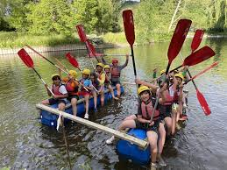
The Federation of St Paul and St Martin of Porres Catholic Primary Schools
YEAR 6 RESIDENTIAL TRIP

Slide 2



Personal Development
Independence: packing / organising / being responsible / managing their own time
Confidence: new activities / being away from home / builds resilience
Teamwork: Pupils learn to cooperate, share, and solve problems
Social Skills
Strengthens friendships / make new friends
Encourages empathy / communication / respect for others in a shared environment
Learning Beyond the Classroom
Links to subjects like geography, science, and PE through outdoor and adventurous activities
Encourages curiosity, problem-solving, and real-world learning experiences.
Wellbeing and Fun
Provides a break from routine and screens, giving children time in nature.
Promotes physical activity, adventure, and a sense of achievement.
Transition to Secondary School
Help pupils build confidence and social maturity before starting secondary school.

Slide 3

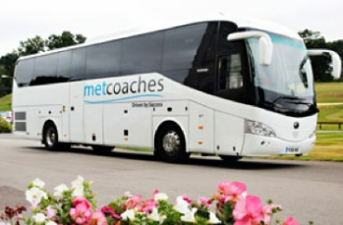
St Paul’s Primary School:
Rob Myrvold – Group Lead
Eliz Yusuf – Yr 4 Teacher
Kevin Butler – Yr 6 TA
Maggie Shook – EYFS Practitioner
St Martin Porres Primary School:
Andrea Smith / Fran Mahon

Slide 4

Monday 9th November – Friday 13th November 2026
School departure and pick-up time:
Departing from the school on Monday 7:30 and 8:00 am
Children need to arrive in school 15 minutes before pick up.
Arriving back to school on Friday at approximately 5:00 – 5:30 pm
*A text message will be sent to parents/carers near the arrival time back at school on Friday.

Slide 5

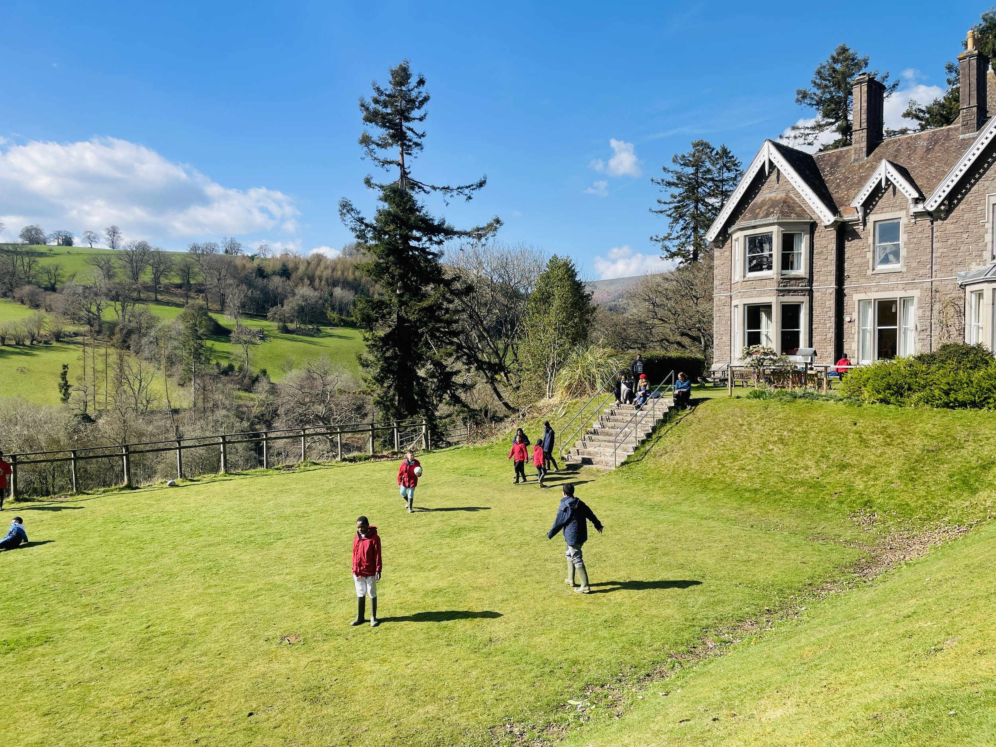
The location: Pendarren House, Llangenny, Crickhowell NP8 1HE
https://www.pendarren.org/home
The sleeping arrangements will be organised by the class
teachers and the children will learn who they in the rooms
with on arrival. The children are sleeping in the main house.
*We understand that sleeping arrangements can cause
a worry for your child and we explained to the students that
each of them will have at least one good friend in the room.

Slide 6
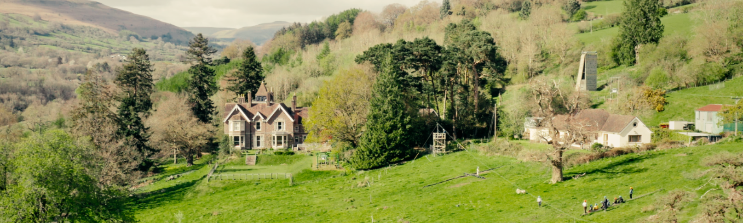

Slide 7
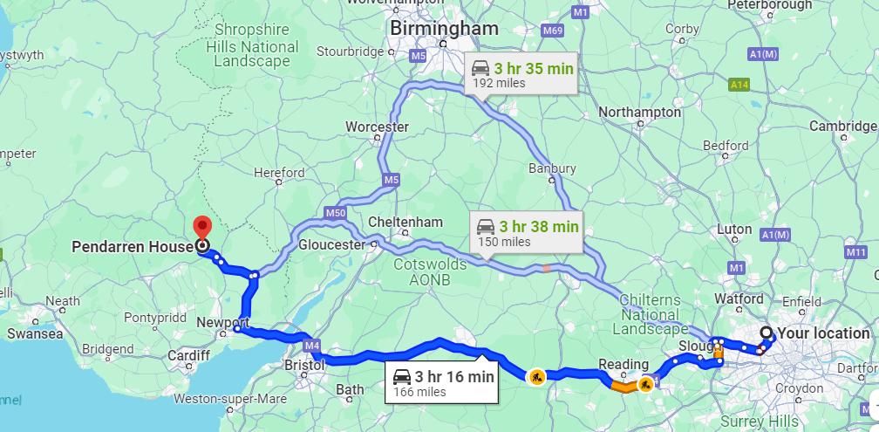
Location and Journey

Slide 8
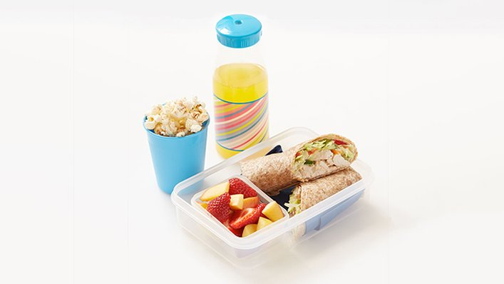
What to Bring for the Journey?
Water bottle
A filling snack
Tissues
We will stop at the services, where children will be able to use the toilet and stretch their legs.
We will arrive at Pendarren for lunch.
The journey is approximately 4 hours.

Slide 9

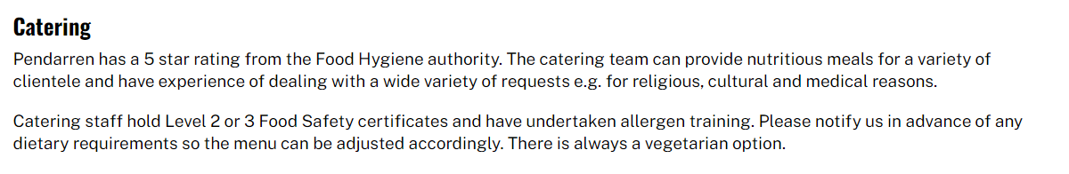


Slide 10


You will be asked to fill in medication forms that will be needed before or during the trip.
Please label all medication and place in a clear zip bag.
The medication will be collected by Friday 6th November.
There will be staff in charge of the medication.

Slide 11

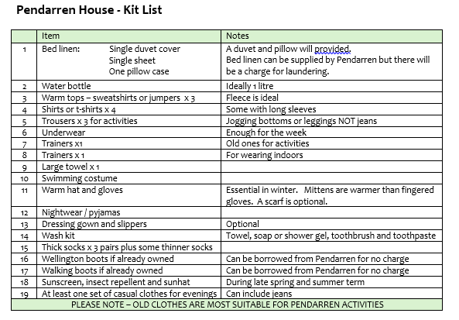

* Pack one set of evening clothes as we might have a disco!☺

Slide 12
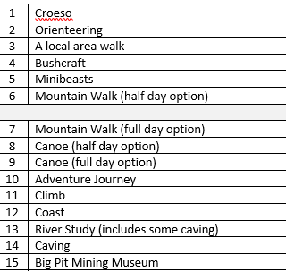
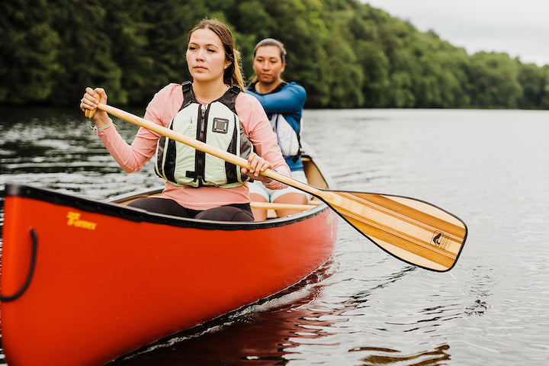
Activities

Slide 13


Full risk assessments have been carried out and safety is very important.
Activities are aimed at challenging children in a supportive environment.
Staffing ratios will meet or exceed the national guidelines. This way, good working relationships are formed to push children to reach their potential.
Our residential visit is about making positive memories and we want children to have a
memorable experience.

Slide 14

It is not necessary to bring a mobile phone / air tags on our residential visit.
Please leave all valuable items and electronics at home.
School will receive regular updates on how the group are doing and will share these with parents. Photos of the activities will be posted on the school website under ‘news and events’.
In case of an emergency please phone the school and the office will contact the staff responsible for your child.

Slide 15


There is a small shop at Pendarren selling sweets and small souvenirs, such as pencils, rubbers, mugs, etc.
Your child is permitted to bring no more than £10 in £5s and change.
Please send your child’s money in a named purse or wallet, or zip pouch and hand it in to a member of staff on Friday 6th November.

Slide 16
Any questions?

