Slide 1
Welcome to
St. Martin of Porres
Catholic Nursery

Slide 2
The Catholic Life of the School
The Catholic Values and traditions permeate through all of the life of the school.
Children have daily opportunities for collective worship
As the year goes on the Nursery children will join the rest of the school for assemblies and Masses
Notes:
Prayer: ST. Martin of Porres was called the Father of the Poor. He lived by the saying of Our Lord: “Truly I say to you, as you did it to one of the least of these my brethren you did it to me” (Mt 25:40). He spent himself in caring for the poor, the suffering, and the afflicted in all of whom he saw Our Saviour
Catholic School Set up in 1972 – taking children from St. Paul’s parish
Now serve a number of parishes

Slide 3
Who will be working with your children?
Class Teacher: Ms Mahon
Nursery Nurses: Miss Bell and Mrs Siriwardena
EYFS Co-ordinator: Miss Mc Eneaney
Executive Head Teacher: Mrs Fleming

Slide 4
Our Nursery Day
8:45am: Nursery doors open
9:00am: Registration
11:45pm: Lunch
12:15pm: End of lunch
1:00pm Afternoon session
3:15pm: End of the day
Notes:
Integrated – so no breaks.
Learning indoors and out
Children won’t even realise that they are learning!
Different from independent nurseries – we ask that you stick to these times for arrival and collection
School collection – must know who is going to collect your children – inform in writing if someone different from normal

Slide 5
The Extended Day
8:00am – 8:45am: Breakfast Club
3:15pm – 6:00pm: After School Club
Notes:
Integrated – so no breaks.
Learning indoors and out
Children won’t even realise that they are learning!
Different from independent nurseries – we ask that you stick to these times for arrival and collection
School collection – must know who is going to collect your children – inform in writing if someone different from normal

Slide 6
Part-time? Full-time?
Three options…
15 hours – 3 hours for 5 mornings or over 3 days
30 hours – 6 hours per day – parents must apply for the 30
hours free provision
Extra sessions are available - £20.00 per session

Slide 7
How do the children spend their time in school?
The Characteristics of the Foundation Stage Curriculum
Prime Areas:
• Communication and Language
• Personal, Social and Emotional Development
• Physical Development
Specific Areas:
• Literacy
• Mathematics
• Understanding the World
• Expressive Arts and Design
Notes:
The children will say that they have played all day
Offer opportunities to develop your children’s skills through their interests
Indoor and outdoor learning opportunities
Both the Prime and Specific areas will be taught through
• Playing and exploring
• Active Learning
• Creating and thinking critically
Text rich environment

Slide 8
Notes:
The children will say that they have played all day
Offer opportunities to develop your children’s skills through their interests
Indoor and outdoor learning opportunities
Both the Prime and Specific areas will be taught through
• Playing and exploring
• Active Learning
• Creating and thinking critically
Text rich environment

Slide 9
Medication in school
We cannot give medicines in school unless it has been prescribed by your doctor and it is in the original container from the pharmacist.
A medical consent form must also be signed by the parent/carer.
Please keep your child off school for 48 hours following sickness and/or diarrhoea.
Talk to us about any health issues that may affect your child.
If the Nursery team feel your child is unwell, we will contact you to discuss the best option for your child.

Slide 10
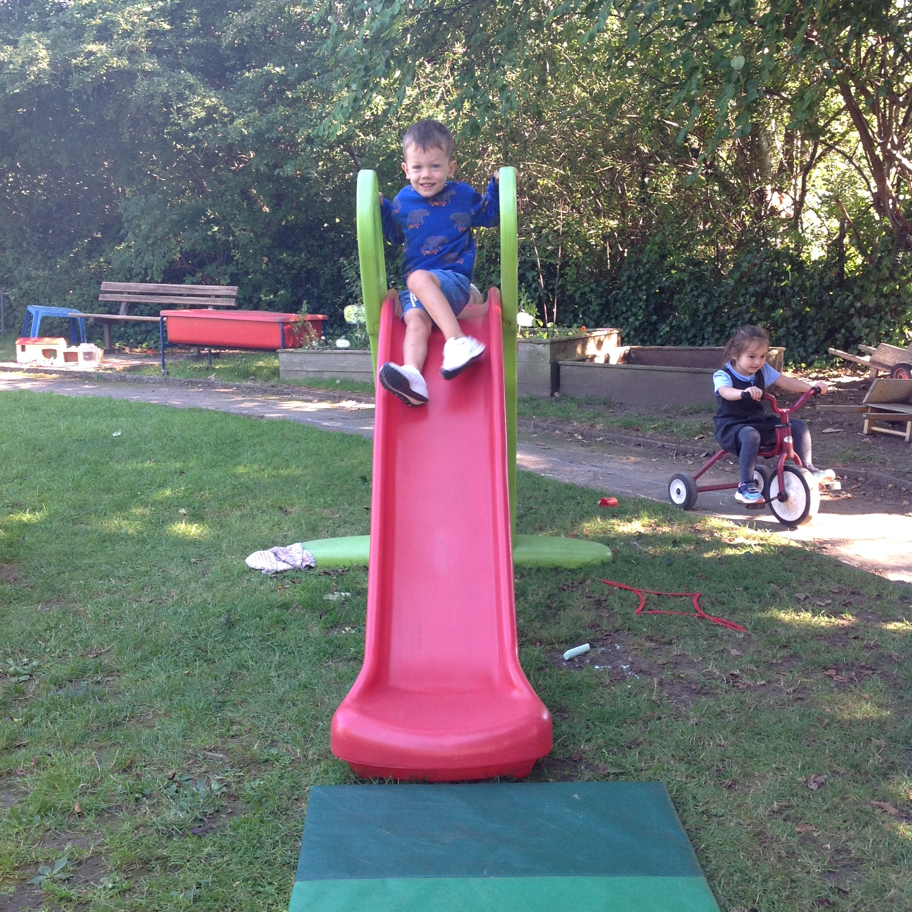
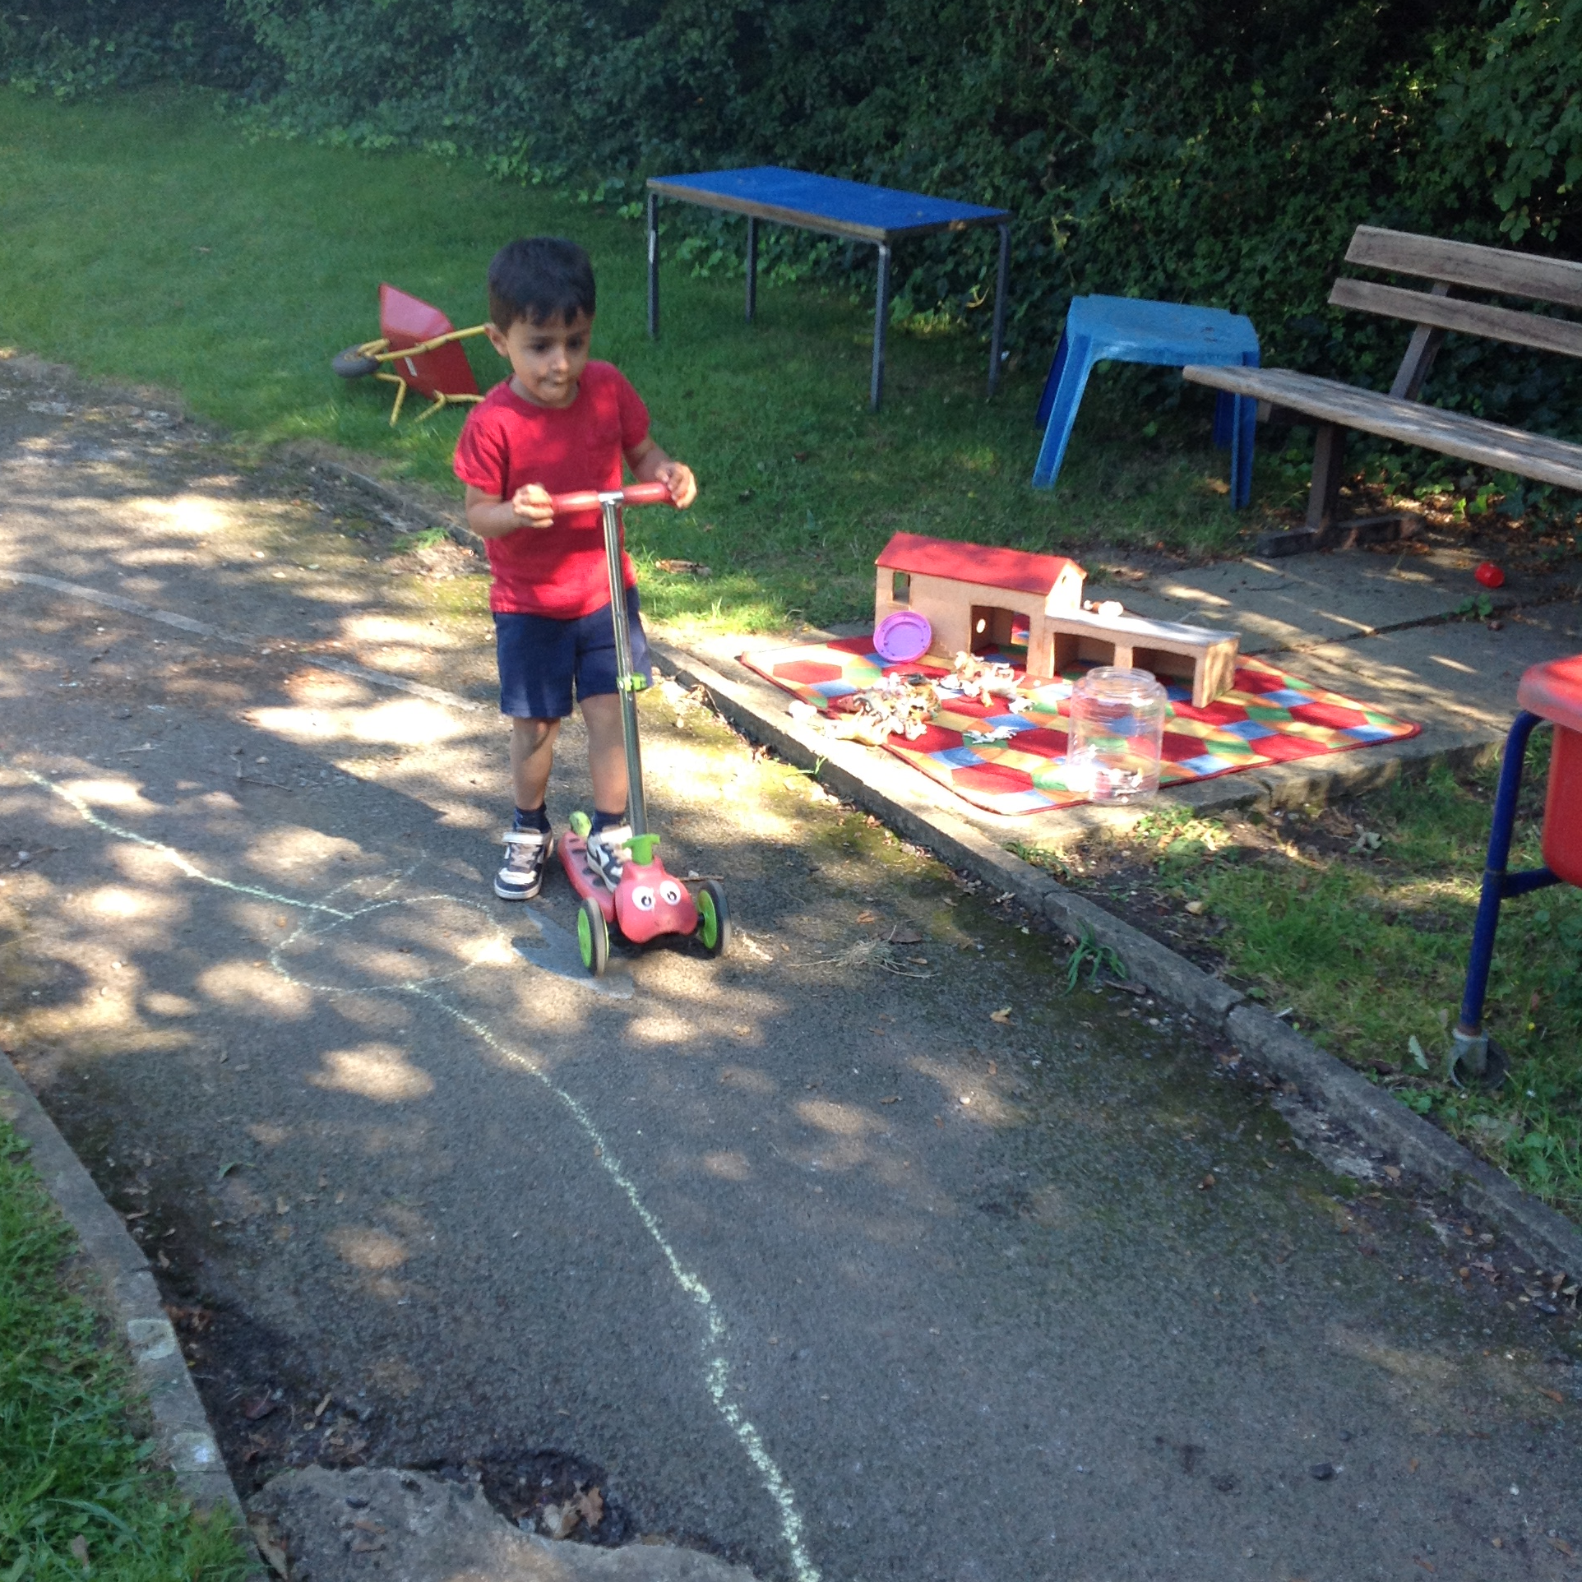
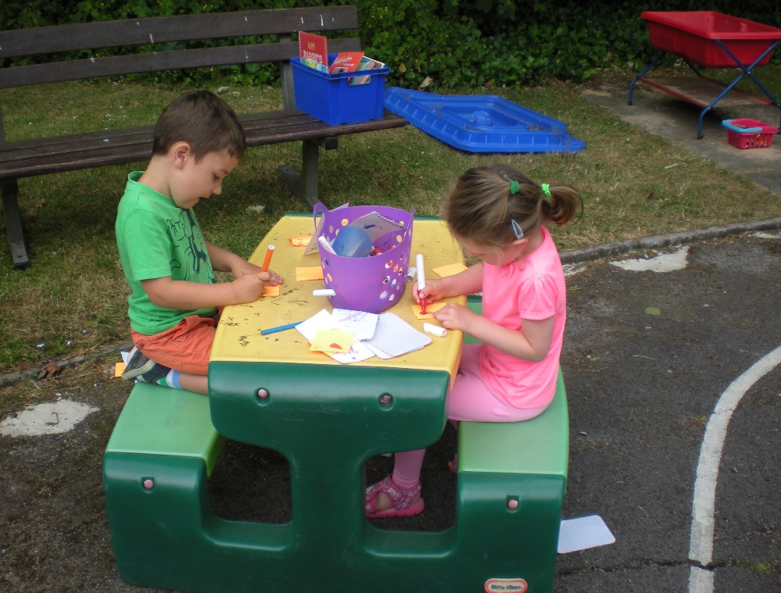
How will your child be spending their time?

Slide 11
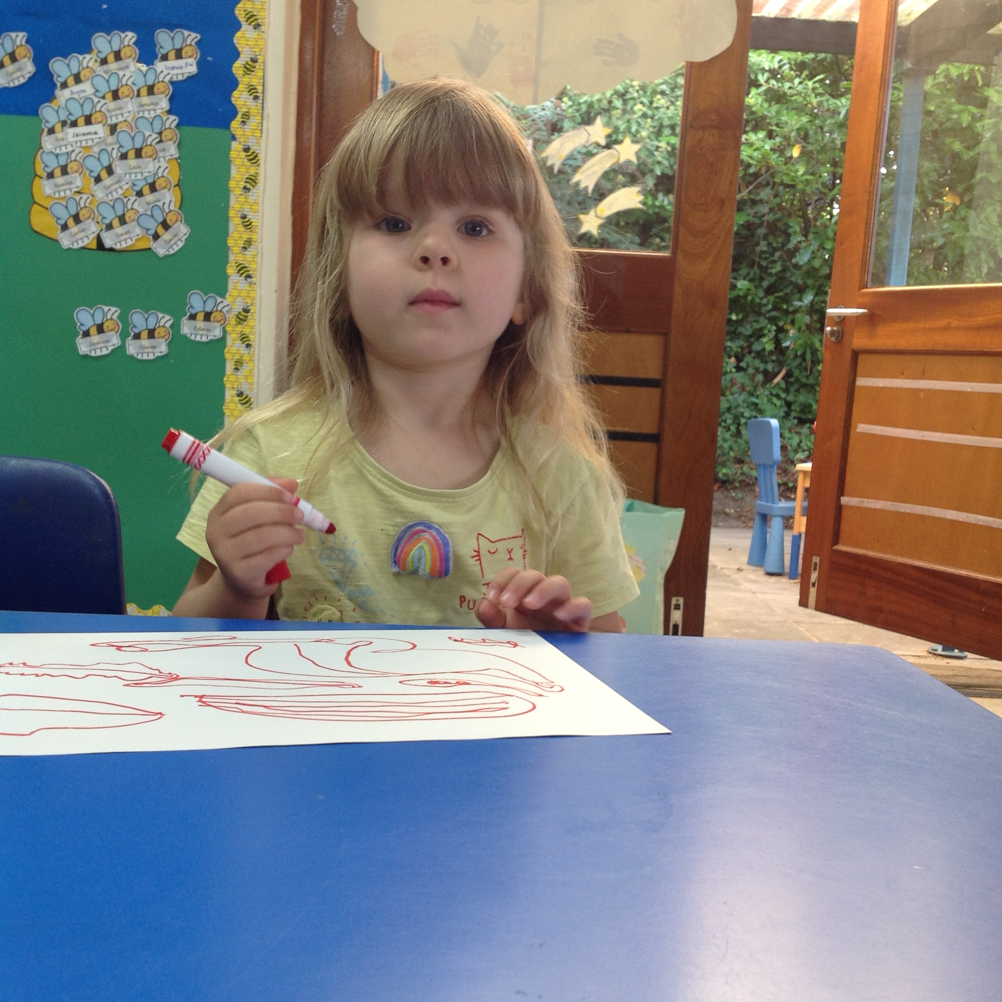
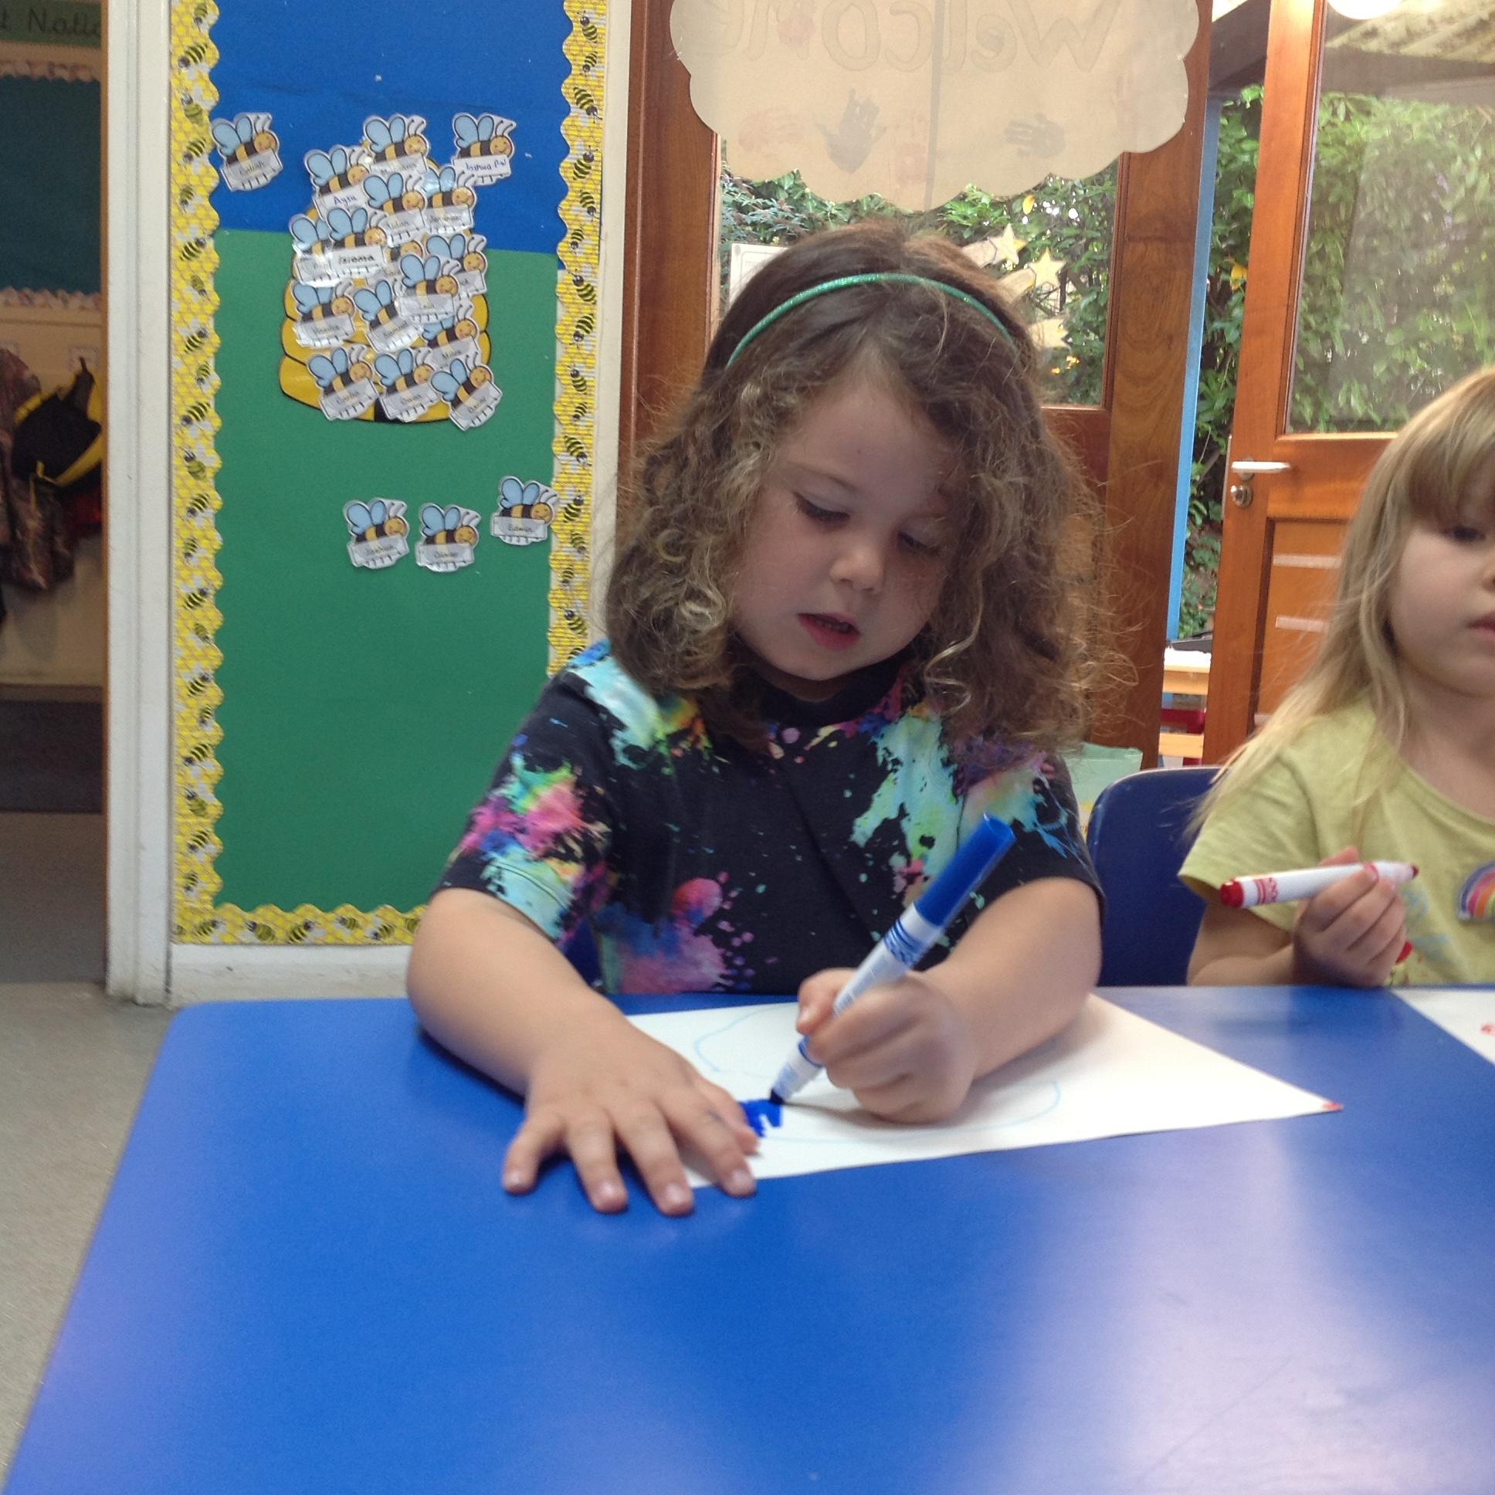
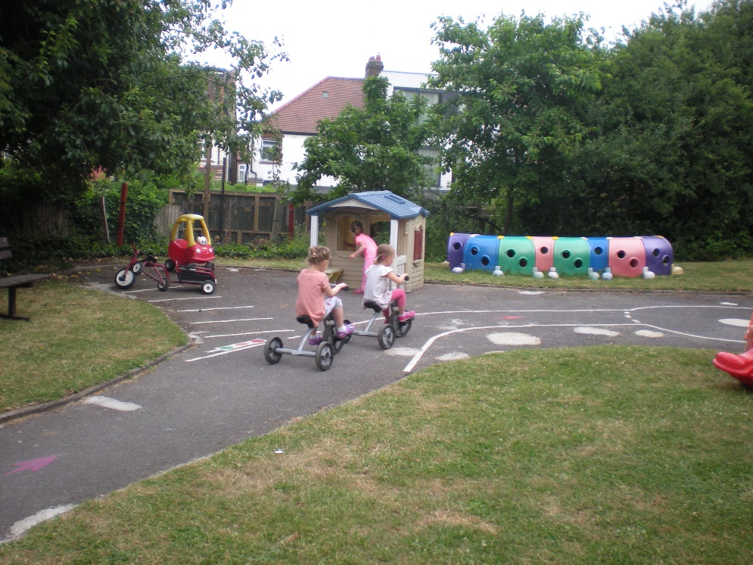
How will your child be spending their time?

Slide 12
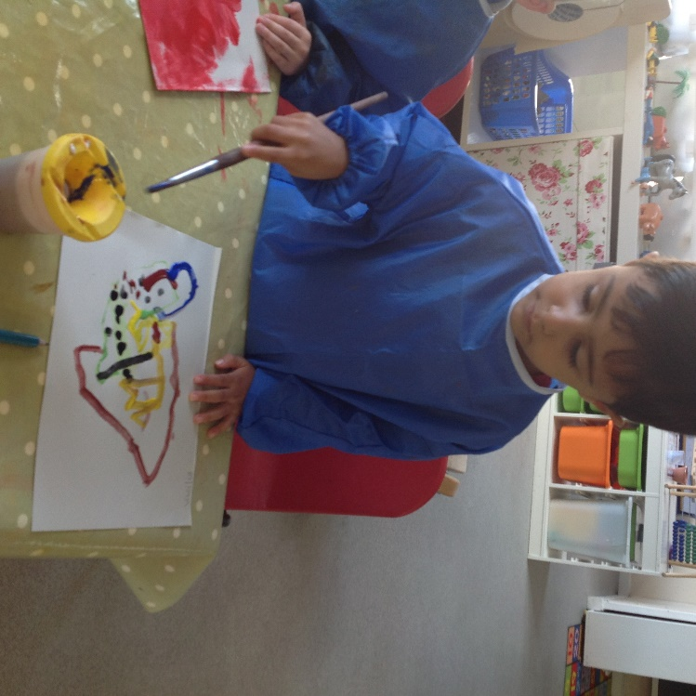
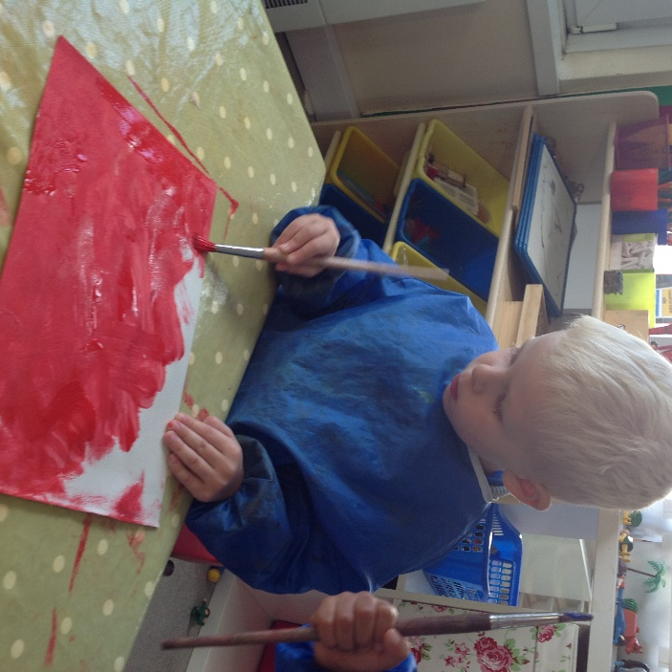
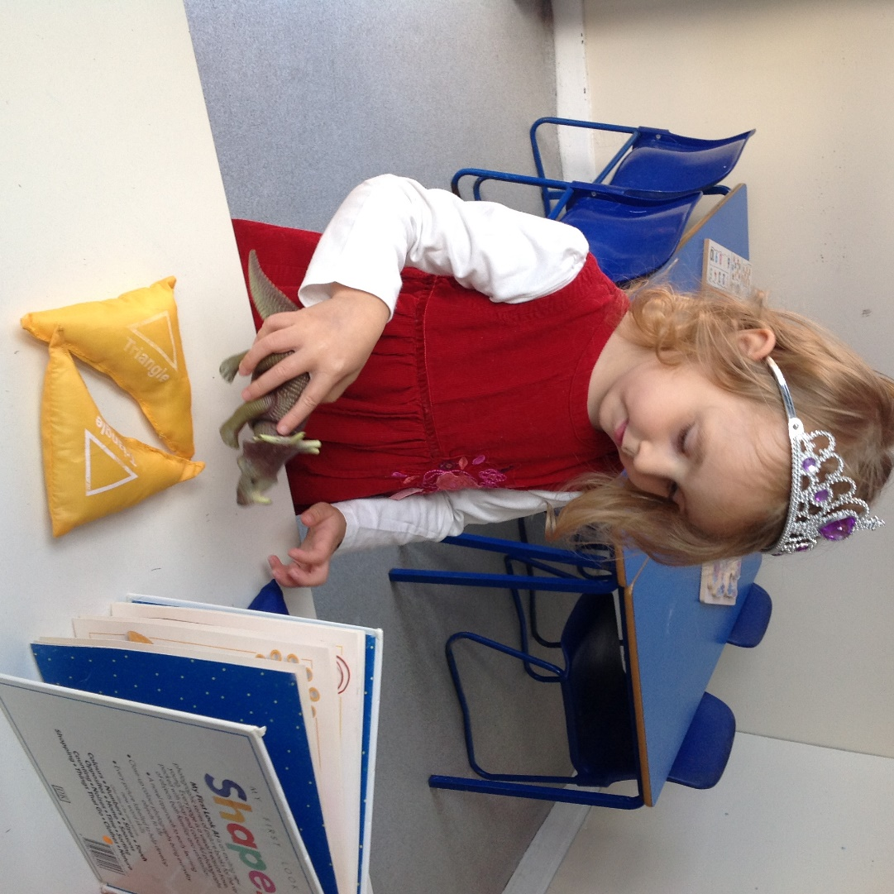
How will your child be spending their time?

Slide 13
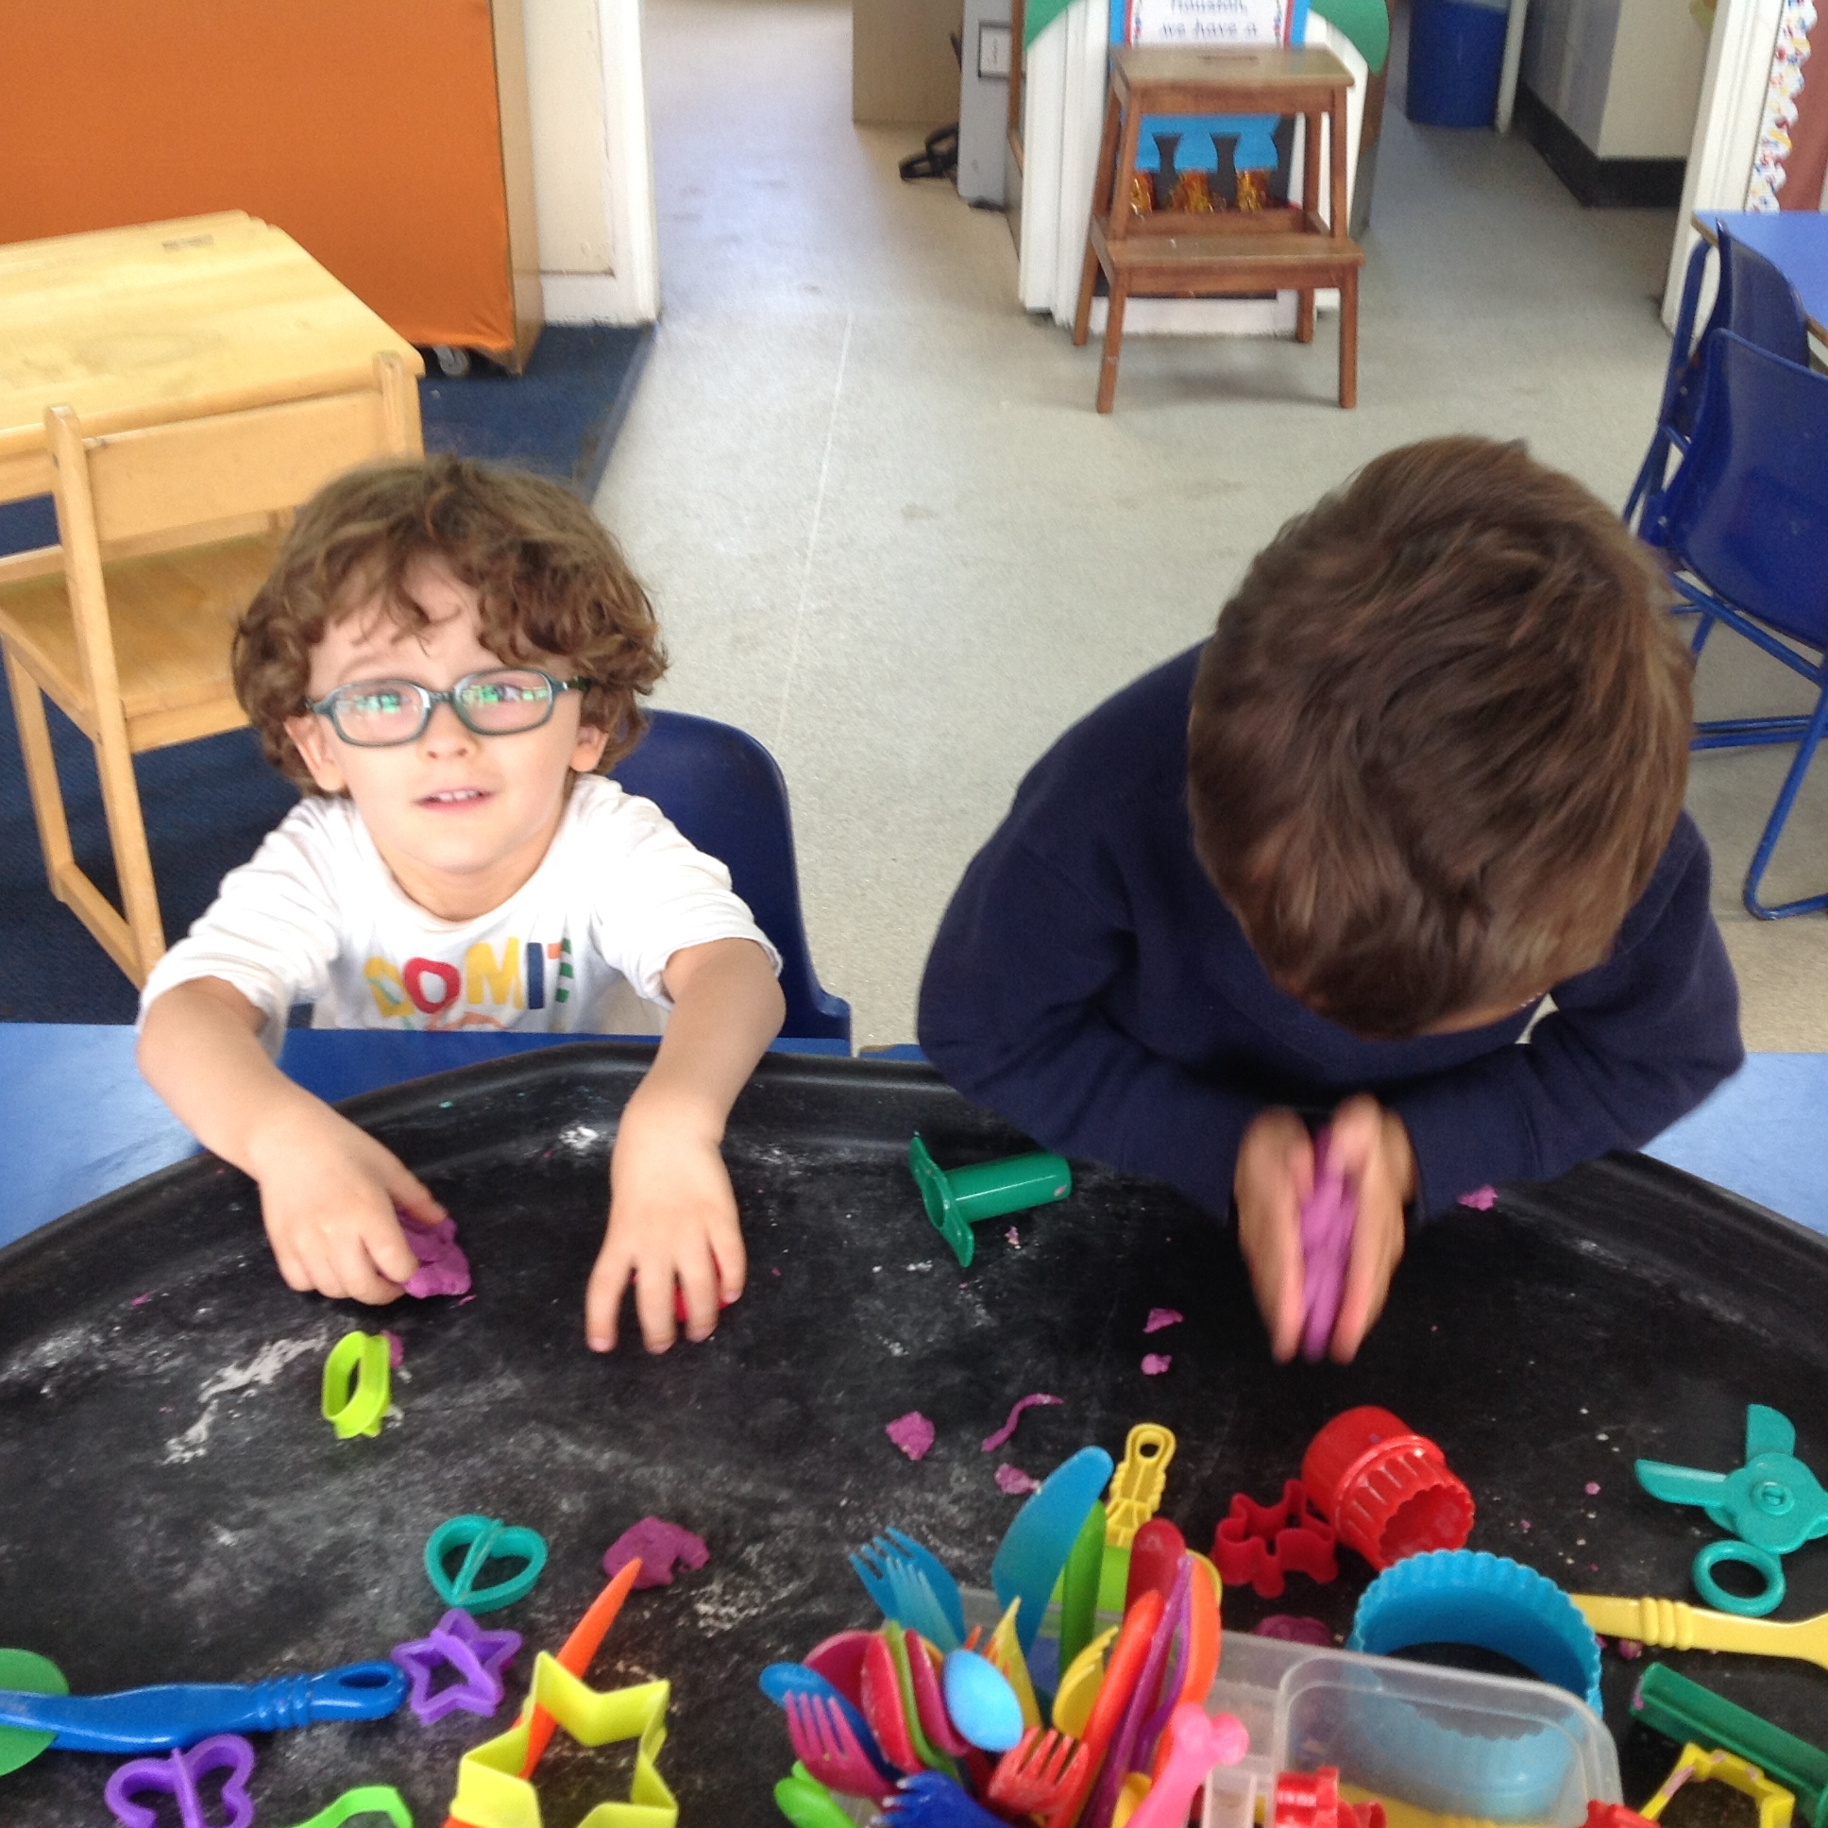
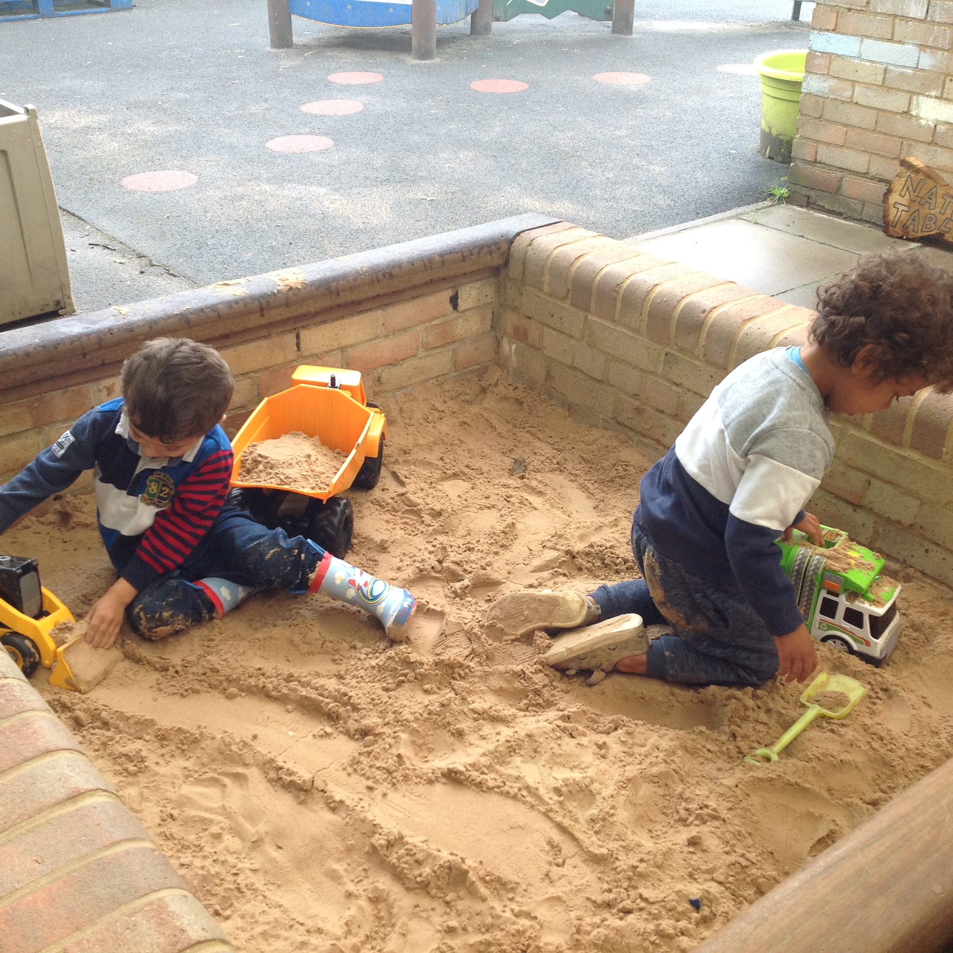
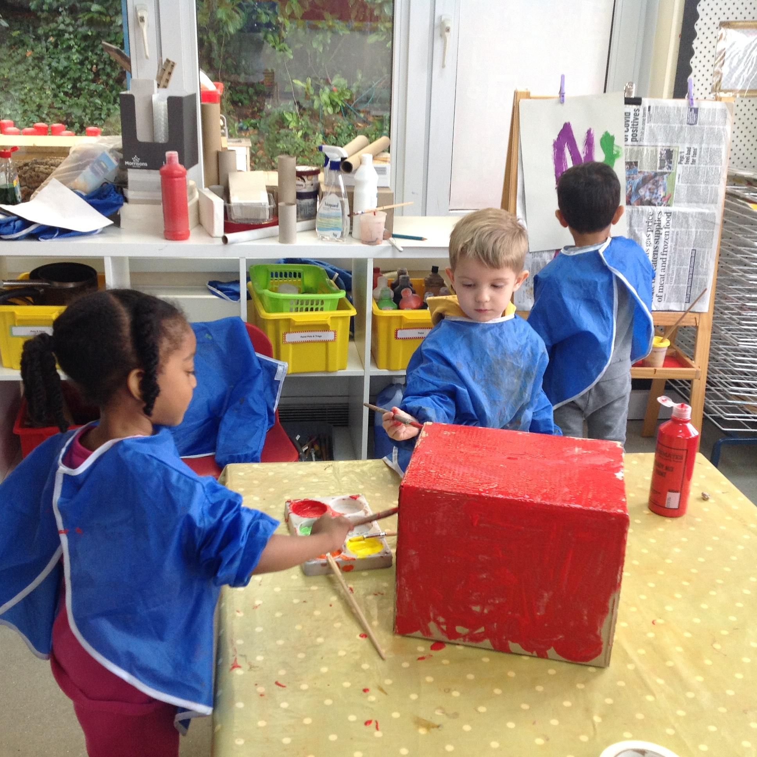
How will your child be spending their time?

Slide 14
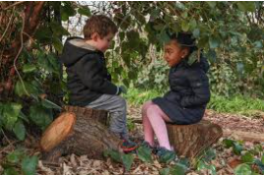
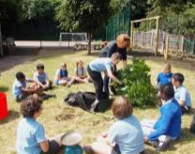
Forest School Friday
We are a Forest School inspired Nursery and we promote the benefits of early childhood education that takes place outdoors in our woodland area. The curriculum is fluid, focused on learner-led outdoor play and it encourages curiosity and exploration.
Notes:
Child’s work to read out

Slide 15
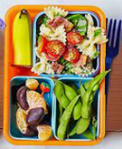
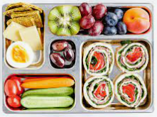
Lunch at School
Packed lunches – no nuts please!
We are a healthy, sugar smart school
Water to drink

Slide 16
A Healthy School
At St. Martin’s we encourage our children to lead a healthy lifestyle. We want them to think about their health and physical activity and the effects of the environment around them.
We encourage parents to walk their children to school. If parents need to travel by car we ask that they ‘park and stride’.
Fruit is provided, free of charge, to all children from Nursery to Year 2.

Slide 17
A Healthy School
Milk is provided, free of charge, to all children in the Nursery.
The Daily Mile

Slide 18
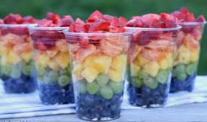
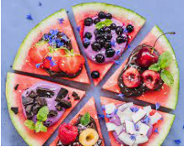
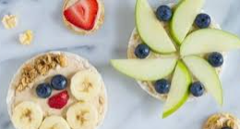
Birthdays
We will celebrate your children’s birthday in the Nursery – we ask that you send in fruit or a book rather than sweets or cake. You might consider purchasing something from the Amazon wish list as a gift to the school.

Slide 19
Communication
Please notify the school office is your child is absent - you can do this by telephone or email or by the School App.
Notify the school also if your child has an appointment and try to take dental and medical appointments out of term time if possible.
It is your responsibility to make sure the school has an up to date email address so that you can be contacted in case of an emergency.
We discourage family holidays during term time as this can interfere with your child’s learning.
School Website - www.stmartinofporres.co.uk

Slide 20
Questions
If you have any questions please ask!
If you think of something at the end of this zoom meeting that you wish to ask, please feel free to contact the school office by email or telephone. We are always on hand to answer your questions.
Notes:
Child’s work to read out

Slide 21
Thank you for attending our Nursery Curriculum Meeting
and we look forward to welcoming you into our
St Martin of Porres community.

